Slide 1

ONLINE RETAIL STORES DATABASE
PREPARED BY MANDAR CHILE
IT VEDANT

Slide 2
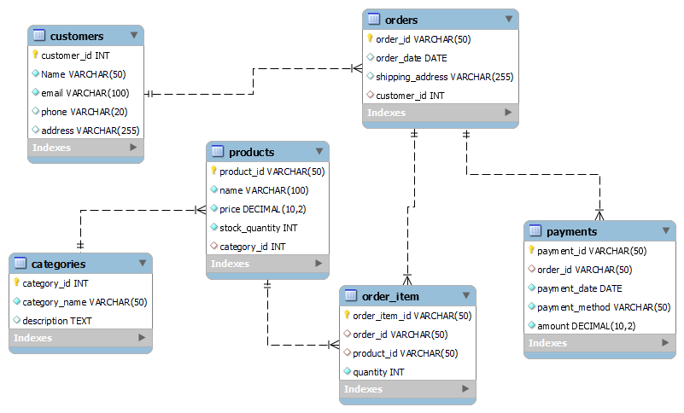
ER DIAGRAM

Slide 3
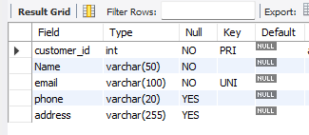
STRUCTURE OF TABLES
SYNTAX : DESC CUSTOMERS;

Slide 4
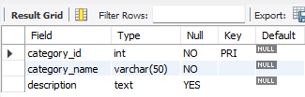
STRUCTURE OF TABLES
SYNTAX : DESC CATEGORIES ;

Slide 5
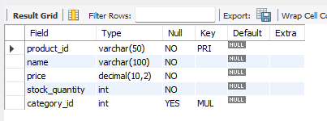
STRUCTURE OF TABLES
SYNTAX : DESC PRODUCTS;

Slide 6
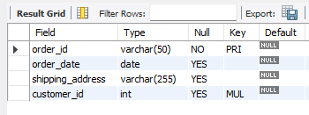
STRUCTURE OF TABLES
SYNTAX : DESC ORDERS;

Slide 7
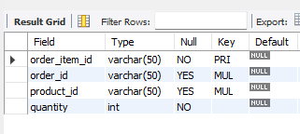
STRUCTURE OF TABLES
SYNTAX : DESC ORDER_ITEM;

Slide 8
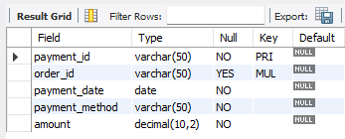
STRUCTURE OF TABLES
SYNTAX : DESC PAYMENTS;

Slide 9
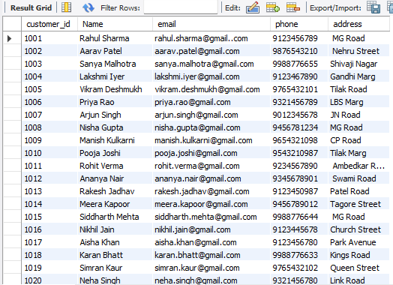
CONTENTS OF TABLES
SYNTAX : SELECT * FROM CUSTOMERS;

Slide 10
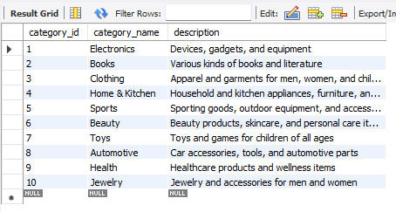
CONTENTS OF TABLES
SYNTAX : SELECT * FROM CATEGORIES ;

Slide 11
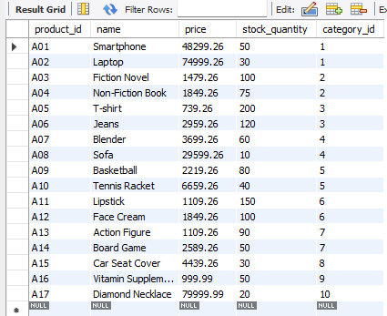
CONTENTS OF TABLES
SYNTAX : SELECT * FROM PRODUCTS;

Slide 12
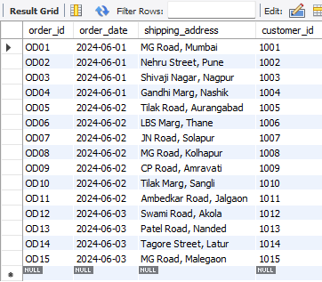
CONTENTS OF TABLES
SYNTAX : SELECT * FROM ORDERS;

Slide 13
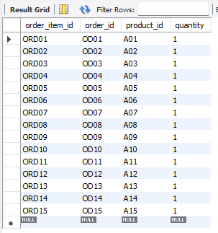
CONTENTS OF TABLES
SYNTAX : SELECT * FROM ORDER_ITEM;

Slide 14
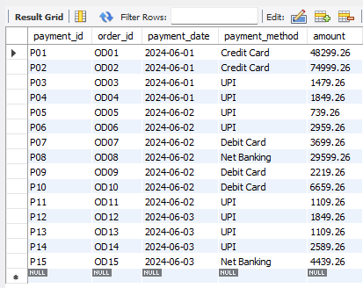
CONTENTS OF TABLES
SYNTAX : SELECT * FROM PAYMENTS;

Slide 15
SUB QUERIES

Slide 16
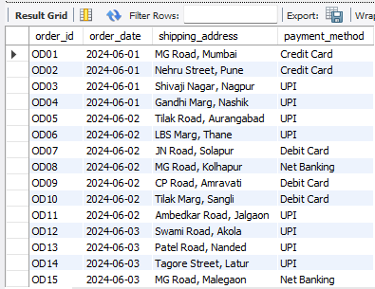
SUB QUERY
Retrieve the order details along with the corresponding payment method:
Syntax:
SELECT o.order_id, o.order_date, o.shipping_address, (SELECT payment_method FROM Payments WHERE Payments.order_id = o.order_id) AS payment_method
FROM Orders o;

Slide 17
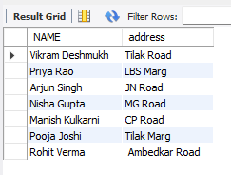
SUBQUERY
Get the name and addresses of customers who placed orders on '2024-06-02':
Syntax:
SELECT NAME,address FROM Customers
WHERE Customer_ID IN (SELECT customer_id FROM Orders WHERE order_date = '2024-06-02);

Slide 18
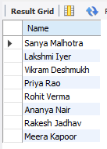
SUBQUERY
Find the names of customers who have made payments using ‘UPI':
SELECT Name FROM Customers
WHERE Customer_ID IN (SELECT customer_id FROM Orders WHERE order_id IN (SELECT order_id FROM Payments WHERE payment_method = 'UPI'));

Slide 19
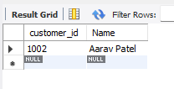
SUBQUERY
Get the highest spending customer
SELECT c.customer_id, c.NameFROM Customers cWHERE c.customer_id = ( SELECT o.customer_id FROM Orders o
JOIN Payments p ON o.order_id = p.order_id
GROUP BY o.customer_id ORDER BY SUM(p.amount) DESC LIMIT 1 );

Slide 20
JOINS

Slide 21
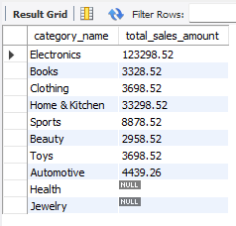
Joins
Retrieve the total sales amount per category:
SYNTAX:
SELECT c.category_name, SUM(p.price * oi.quantity) AS total_sales_amount
FROM Categories c
LEFT JOIN Products p ON c.category_id = p.category_id
LEFT JOIN Order_item oi ON p.product_id = oi.product_id
GROUP BY c.category_name;

Slide 22
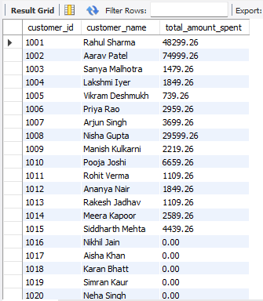
JOINS
Get the total amount spent by each customer, including customers who have not placed any orders:
SYNTAX:
SELECT c.customer_id, c.Name AS customer_name, COALESCE(SUM(p.amount), 0) AS total_amount_spent
FROM Customers c
LEFT JOIN Orders o ON c.customer_id = o.customer_id
LEFT JOIN Payments p ON o.order_id = p.order_id
GROUP BY c.customer_id, c.Name;

Slide 23
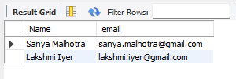
JOINS
Find the names and email addresses of customers who ordered items in the 'Books' category:
SYNTAX:
SELECT c.Name, c.emailFROM Customers c
JOIN Orders o ON c.Customer_ID = o.customer_id
JOIN Order_item oi ON o.order_id = oi.order_id
JOIN Products p ON oi.product_id = p.Product_id
JOIN Categories cat ON p.category_id = cat.category_id
WHERE cat.category_name = 'Books';

Slide 24
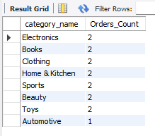
JOINS
Retrieve the categories of products along with the number of orders placed for each category:
Syntax:
SELECT cat.category_name, COUNT(o.order_id) AS Orders_Count FROM Categories cat
JOIN Products p ON cat.category_id = p.category_id
JOIN Order_item oi ON p.Product_id = oi.product_id
JOIN Orders o ON oi.order_id = o.order_id
GROUP BY cat.category_name;

Slide 25
THANK YOU

